Slide 1
Flexible Spending Account
McGriff Flexible Benefit Solutions
McGriff.com/flex

Slide 2
What is a Flexible Spending Account?
Set money aside, before taxes, for qualified Health care and/or Dependent Day Care expenses.
(Save up to 30% on eligible healthcare expenses!*)
All Health FSA funds available day 1
Plan ahead
*Based on a 30% tax bracket.
FSA
Health Flexible Spending Account Plan
DCA
Dependent Care Account Plan

Slide 3
Health FSA Plan Overview
Provides employees to set money aside, before taxes, for healthcare expenses. (Save up to 30% on eligible healthcare expenses!*)
All funds available day 1 for participants to use on eligible expenses not covered by insurance or other medical reimbursement plans
Optimize FSA funds by planning ahead for known expenses – IRS sets benefit maximum limits each year. 2022 - $2,850
Expenses can only be incurred by the employee, the employee’s spouse, the employee’s child up to age 26 (within the tax year) and a tax dependent.
*Based on a 30% tax bracket.

Slide 4
Health FSA Eligible Expenses
What can an FSA be used for?
There are thousands of eligible items including:
Copays and coinsurance
Doctor visits and surgeries
Prescription drugs
Over-the-counter medications (first-aid, allergy, asthma, cold/flu, heartburn, pain medication, etc.)
Menstrual products
COVID Related Personal Protective Equipment (PPE)
Birthing and Lamaze classes
Dental and orthodontia
Frames, contacts, prescription sunglasses, etc.
Massage therapy, vitamins and supplements

Slide 5
FSA Annual Contribution Limit
Use-or-lose
Don’t forget to spend your FSA dollars. You will forfeit any money over $570 left in your account at the end of the plan year.
2022 Health FSA maximum annual election: $2,850
Contribute and spend funds tax-free
Pay for eligible out-of-pocket healthcare expenses
Check with your employer to confirm how many days you have to submit claims for reimbursement after the plan year ends.

Slide 6
Changes to FSA Elections
Experience a Qualifying Life Event (QLE):
Change in marital status
Change in the number of dependents
Change in employment status
Change in dependent status
Judgement, decree or order
Change must be consistent with the QLE. Examples:
Decreasing the FSA contribution because of legal separation or divorce
Increasing the FSA contribution because of marriage or adding a dependent

Slide 7
FSA Carryover and Claim Filing
Your plan year is: January 1, 2023 to December 31, 2023.
You have a carryover, which means you can roll over up to $570 into the next year.
Last day to file a claim: March 31, 2024

Slide 8
What is a Dependent Care FSA?
What does it cover?
The list includes, but is not limited to:
Child-care center, babysitter, nanny (birth through age 12)
Summer day camp
Before- or after-school care
Disabled dependent and/or spouse care
Elder care
Set money aside, before taxes, for dependent care expenses.
Tax savings
To be eligible for a dependent care FSA, both you and your spouse (if applicable) must work, be looking for work or be
full-time students.

Slide 9
Dependent Care FSA Annual Contribution Limit
Use-it-or-lose-it Reminder
Any unspent funds will be forfeited any money left in participant’s account at the end of the plan year.
Dependent Care FSA maximum annual election:
$5,000 per household
$2,500 per person (if married or filing separately)
Contribute and spend funds tax-free
Pay for eligible out-of-pocket dependent care expenses
Check with your employer to confirm how long you have to submit claims for reimbursement after the plan year ends.

Slide 10
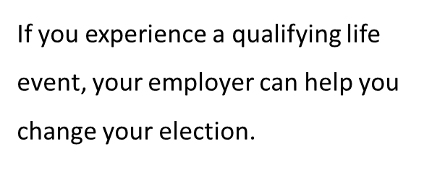
Changes to Dependent Care FSA Elections
To make changes to elections after open enrollment, participants need to experience a qualifying life event.
These events include:
Change in marital status
Change in the number of dependents
Change in employee or spouse’s employment status
Change in daycare providers
Dependent children turns age 13
Cost of qualified daycare expenses increases or decreases
Judgement, decree or order

Slide 11
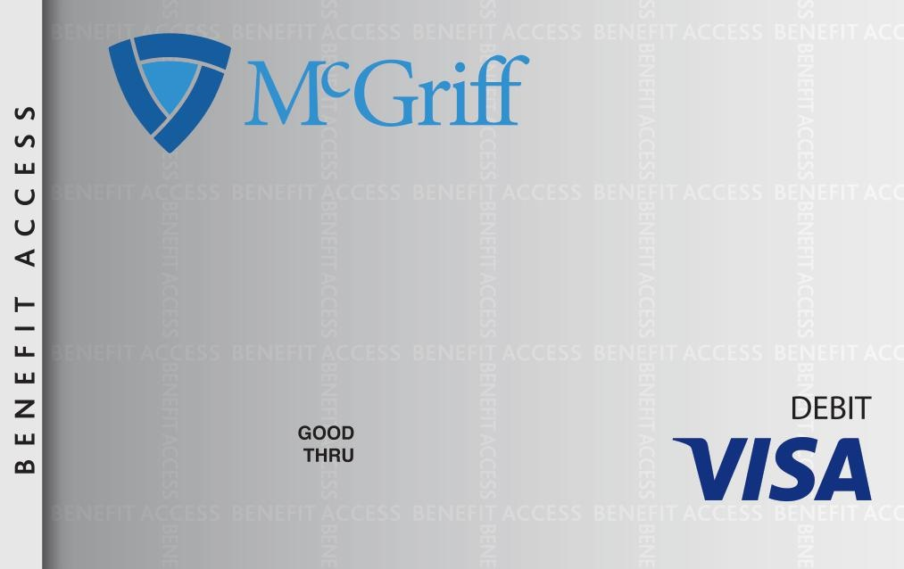
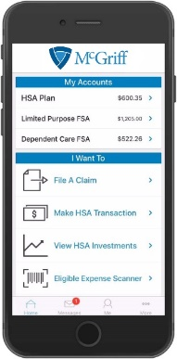
Leveraging Your Account
Once enrolled, you will have access to:
Online account:
www.mcgriff.com/flex
Payment debit card
Mobile app
Use the payment debit card to pay for FSA eligible expenses or pay out of pocket and request a distribution from your account through your online account or mobile app.
Sign up for text alerts to stay up to date on your account.

Slide 12
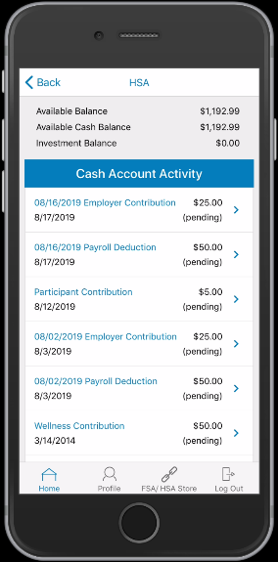
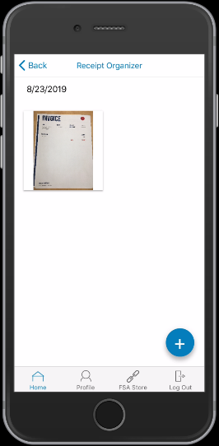
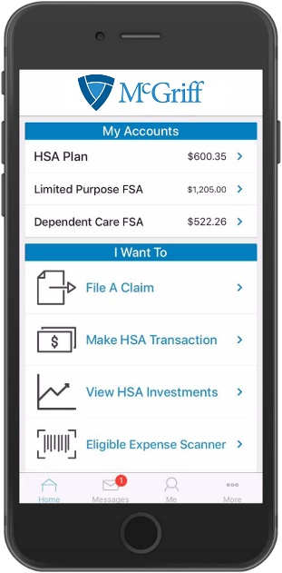
Manage Your Benefits on the go
The mobile app allows you to:
Use fingerprint login to access account(s) with ease
Check balances & account details
View ‘Account Snapshot’ to obtain key account info
Submit and check claims requiring receipts
Snap a photo of a receipt and submit with a new or existing claim, or store in the device’s camera roll for later use in claim filing
Scan a product bar code to determine eligibility as a qualified medical expense
Access account funds to pay yourself or someone else, such as a doctor
View important messages about account(s) and get notifications via text alerts
Click to call or email customer service to report a debit card as lost or stolen

Slide 13
Paula W. Smith, VP, New Business Specialist
7701 Airport Center Dr.
Greensboro, NC 27409
336-291-1204

