Slide 1
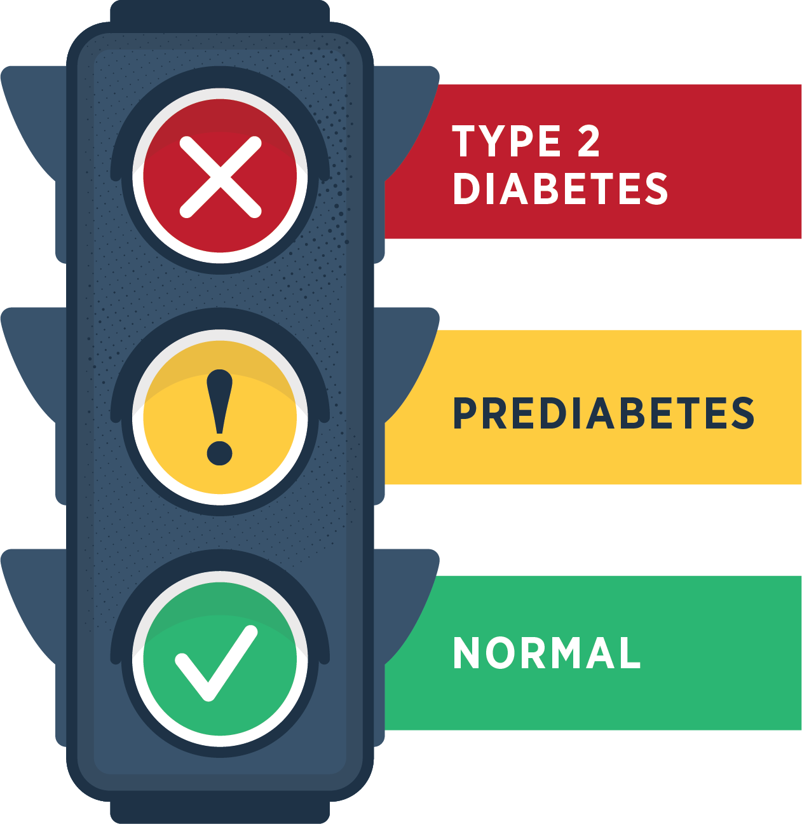
Prediabetes is when your blood sugar level is higher than normal but not high enough yet to be diagnosed as type 2 diabetes.
Notes:
Susan Prediabetes is when your blood sugar level is higher than normal but not high enough yet to be diagnosed as type 2 diabetes

Slide 2

Adults has prediabetes
Don’t know they have it
Notes:
Susan An estimated 88 million Americans—that’s more than 1 out of 3—and likely a growing number of your members— have prediabetes. 9 out of 10 don’t even know they have it.

Slide 3
Without lifestyle changes, people with prediabetes can develop type 2 diabetes.
Diabetes among adults has tripled in the past two decades.
1 in 3 adults in the U.S. could have diabetes by 2050 if nothing changes.
v
!
Notes:
Susan
Unless they make lifestyle changes, many people with prediabetes will develop type 2 diabetes within a few years.
In fact, diabetes in adults has tripled at an alarming rate in the past two decades, and it is estimated that 1 in 3 adults in the United States could have diabetes by 2050 if nothing changes. That’s your current AND future members.

Slide 4
People with type 2 diabetes are at higher risk of serious health complications
Kidney failure
blindness
Loss
of toes, feet, or legs
Heart attack
stroke
Notes:
Susan
People with type 2 diabetes are at higher risk of serious health complications including kidney failure, blindness, heart attack, stroke, and loss of toes, feet, or legs. This is costly to you and to your employees. Type 2 diabetes also impacts your worker’s compensation costs.

Slide 5

The National Diabetes Prevention Program (National DPP)
Lifestyle Change Program
A solution
Notes:
David - There is a solution to the problem of prediabetes―The National Diabetes Prevention Program. Created by the CDC, this evidence-based program can help prevent your employees from becoming diabetic.

Slide 6
The National DPP Lifestyle Change Program
WORKS!
58%
Can prevent or delay type 2 diabetes by
Notes:
David
This program works. And it will work for your members.
We launched this same program for a small company in Gallup last year and had one individual that lost more than 30 pounds and has a healthy A1C today.
Research examining the effects of a structured lifestyle change program like ours and showed that losing 5 to 7 percent of body weight by eating healthy and increasing physical activity reduced the risk of developing type 2 diabetes by 58 percent in people at high risk for the disease. In individuals over 60 years old, it reduced risk by 71 percent.
Evidence is based on a large, rigorously designed randomized control trial with a diverse population.
The impact of the lifestyle intervention was similar, regardless of race, ethnicity, or gender.
Even after 10 years, those who participated in the earlier lifestyle change program had a 34 percent lower rate of type 2 diabetes.

Slide 7
Put the filer here
Talk about the types of offerings
Distance Learning (zoom)
In-person if you can have that
Online (Hope 80/20 anytime within the week.
What they get from participating
Coaching improve your health feel beet and more energetic be part of something bigger
Work/Life balance

Slide 8

Questions?
Notes:
Thank you for your time today!
At this time, I’d like to open the floor for any questions you may have.

